Slide 1



Low Mach Number
Fluctuating Hydrodynamics for Electrolytes
TWENTIETH SYMPOSIUM ON THERMOPHYSICAL PROPERTIES
June 24–29, 2018 -- Boulder, CO, USA
Alejandro Garcia (San Jose State University)
Jean-Philippe Péraud (Corning)
Andy Nonaka (Lawrence Berkeley Nat. Lab.)
Aleksandar Donev (New York University)
John Bell (Lawrence Berkeley Nat. Lab.)

Slide 2
Electrolytes at the Mesoscale
A truly comprehensive understanding of the complexities at the heart of battery electrochemistry requires “connecting the dots” among the multiple phenomena that occur across many length and time scales in an unprecedented way.
Next Generation Electrical Energy Storage report (Dept. of Energy)
Micro
Meso
Fluctuating hydrodynamics is a powerful modeling tool for the study of mesoscopic phenomena

Slide 3



Debye Length
Mesoscopic length scale in an electrolyte is the Debye length.
The fluid is quasi-neutral for length scales significantly larger than the Debye length.
In seawater the Debye length is roughly one nanometer and $λ_{D} ∝1/\sqrt{c}$ where c is the concentration.
-
$$λ_{D}$$
$$λ_{D}$$
+
-
-
-
-
+ + + +

Slide 4




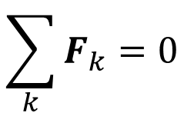
Transport for Species
Hydrodynamic equation for the mass densities, ρ_{k} , for species k has the form,
$∂_{t}ρ_{k}=−∇∙\left(ρ_{k}v\right)−∇∙F_{k}$
$$k=1,…,N$$
where the species flux, F_{k} , is the sum of a deterministic plus a stochastic contribution,
$$F_{k}=\overline{F_{k}}+\tilde{F_{k}}$$
Note that by mass conservation,
$$\sum_{k}{F_{k}=0}$$
so
$$∂_{t}ρ=−∇∙\left(ρv\right)$$

Slide 5
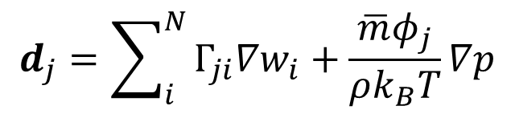
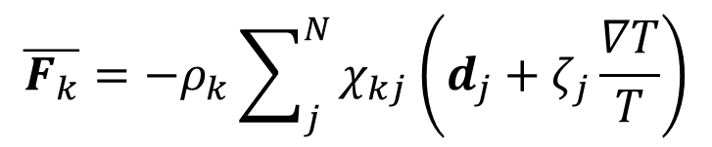

Neutral Species Flux
In Fickian form the deterministic species flux is,
$$\overline{F_{k}}=−ρ_{k}\sum_{j}^{N}{χ_{kj}\left(d_{j}+ζ_{j}\frac{∇T}{T}\right)}$$
Diffusion Coefficients
Thermal Diffusion term
where the diffusion driving force, d, for neutral species is,
$$d_{j}=\sum_{i}^{N}{Γ_{ji}∇w_{i}}+\frac{{\overline{m}φ}_{j}}{ρk_{B}T}∇p$$
$$w_{k}=ρ_{k}/ρ$$
Concentration Gradient term
Barodiffusion term

Slide 6
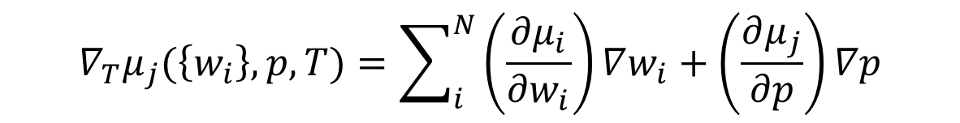
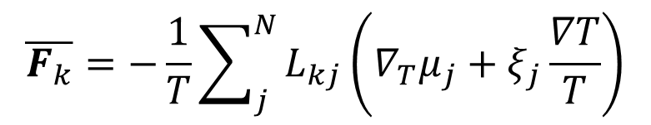
Onsager form
The deterministic species flux may also be written as,
$$\overline{F_{k}}=−\frac{1}{T}\sum_{j}^{N}{L_{kj}\left(∇_{T}μ_{j}+ξ_{j}\frac{∇T}{T}\right)}$$
Onsager Coefficients
where the gradient of chemical potential at constant T is,
$$∇_{T}μ_{j}(\left\{w_{i}\right\},p,T)=\sum_{i}^{N}{\left(\frac{∂μ_{i}}{∂w_{i}}\right)∇w_{i}}+\left(\frac{∂μ_{j}}{∂p}\right)∇p$$
We may match the transport coefficients in the Fickian form to the coefficients in the Onsager form.

Slide 7
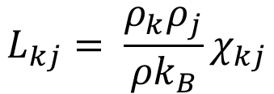
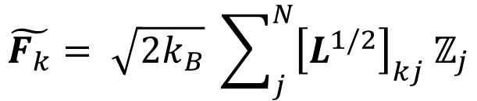
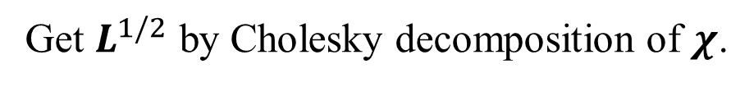
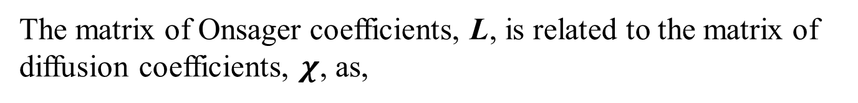
Stochastic Species Flux
The matrix of Onsager coefficients, L, is related to the matrix of diffusion coefficients, $χ$, as,
$$L_{kj}= \frac{ρ_{k}ρ_{j}}{{ρk}_{B}}χ_{kj}$$
By fluctuation-dissipation the stochastic species flus is,
$$\tilde{F_{k}}= \sqrt{2k_{B}} \sum_{j}^{N}{{\left[L^{1/2}\right]}_{kj}{ ℤ}_{j}}$$
Matrix “square root”
White noise
Get $L^{1/2}$ by Cholesky decomposition of $χ$.

Slide 8
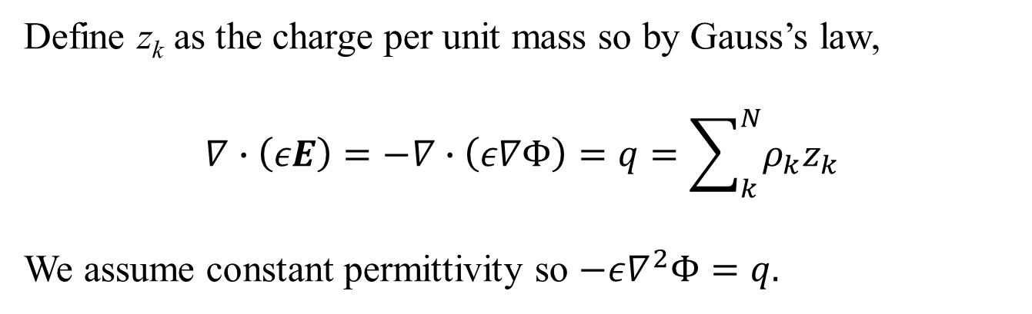
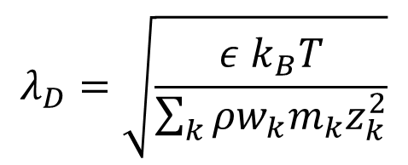
Electric Charge & Field
Define z_{k} as the charge per unit mass so by Gauss’s law,
$$∇∙\left(εE\right)=−∇∙\left(ε∇Φ\right)=q=\sum_{k}^{N}{ρ_{k}z_{k}}$$
We assume constant permittivity so $−ε∇^{2}Φ=q.$
The Debye length is,
$$λ_{D}=\sqrt{\frac{ε k_{B}T}{\sum_{k}{{ρw}_{k}m_{k}z_{k}^{2}}}}$$

Slide 9

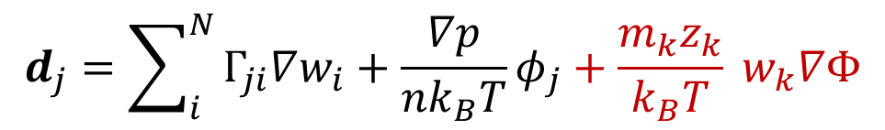
Charged Species Flux
For charged species we introduce the electrochemical potential,
$$μ_{j}^{E}=μ_{j}\left(\left\{w_{i}\right\},p,T\right)+ z_{j}Φ$$
which introduces an additional contribution to the diffusion driving force,
$$d_{j}=\sum_{i}^{N}{Γ_{ji}∇w_{i}}+\frac{∇p}{nk_{B}T}φ_{j}+\frac{m_{k}z_{k}}{k_{B}T} w_{k}∇Φ$$
Potential Gradient term (E-field)
Noise term is unchanged.

Slide 10
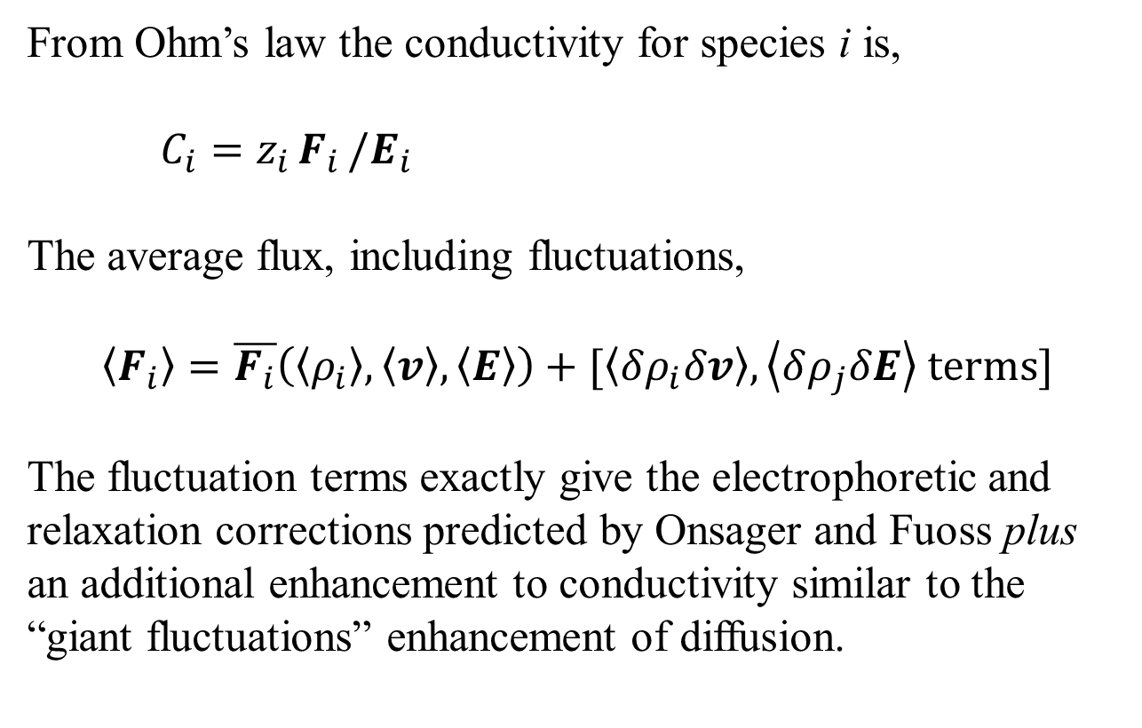
Conductivity & Fluctuations
From Ohm’s law the conductivity for species i is,
$C_{i}=z_{i }F_{i }/E_{i}$
The average flux, including fluctuations,
$$\left\langle F_{i}\right\rangle =\overline{F_{i}}\left(\left\langle ρ_{i}\right\rangle ,\left\langle v\right\rangle ,\left\langle E\right\rangle \right)+[\left\langle δρ_{i}δv\right\rangle ,\left\langle δρ_{j}δE\right\rangle \text{terms}]$$
The fluctuation terms exactly give the electrophoretic and relaxation corrections predicted by Onsager and Fuoss plus an additional enhancement to conductivity similar to the “giant fluctuations” enhancement of diffusion.

Slide 11
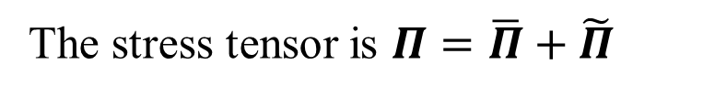
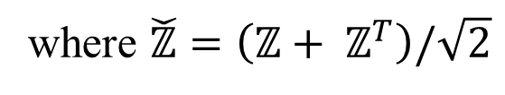
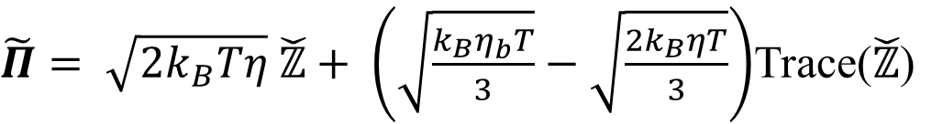
Momentum Equation
The general form of the momentum equation is
$$∂_{t}\left(ρv\right)=−∇∙\left(ρvv^{T}\right)−∇p−∇∙Π+qE+ρg$$
The stress tensor is $Π=\overline{Π}+\tilde{Π}$
$$\overline{Π}=−η\left(∇v+∇v^{T}\right)−\left(η_{b}−\frac{2}{3}η\right)I(∇∙v)$$
$\tilde{Π}= \sqrt{2k_{B}Tη} \check{ℤ}+ \left(\sqrt{\frac{k_{B}η_{b}T}{3}}−\sqrt{\frac{{2k}_{B}ηT}{3}}\right)$Trace($\check{ℤ}$)
where $\check{ℤ}=\left(ℤ+ ℤ^{T}\right)/\sqrt{2}$
This is just a fancy way of writing what’s given in Landau

Slide 12
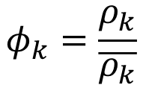

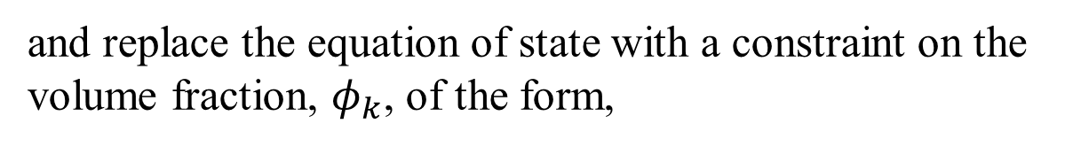
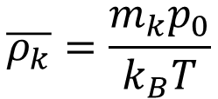
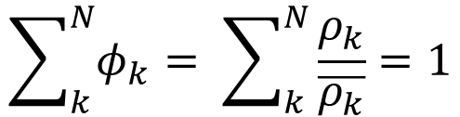
Low-Mach Approximation
In the low-Mach approximation we write,
$$∂_{t}\left(ρv\right)=−∇∙\left(ρvv^{T}\right)−∇π−∇∙Π+qE+ρg$$
and replace the equation of state with a constraint on the volume fraction, $φ_{k}$, of the form,
EOS Constraint
$$φ_{k}=\frac{ρ_{k}}{\overline{ρ_{k}}}$$
so
$$\sum_{k}^{N}{φ_{k}}= \sum_{k}^{N}{\frac{ρ_{k}}{\overline{ρ_{k}}}}=1$$
For example, for an ideal gas mixture at pressure p₀,
and
$$\overline{ρ_{k}}=\frac{m_{k}p_{0}}{k_{B}T}$$
$$φ_{k}=x_{k}$$
Mole fraction

Slide 13
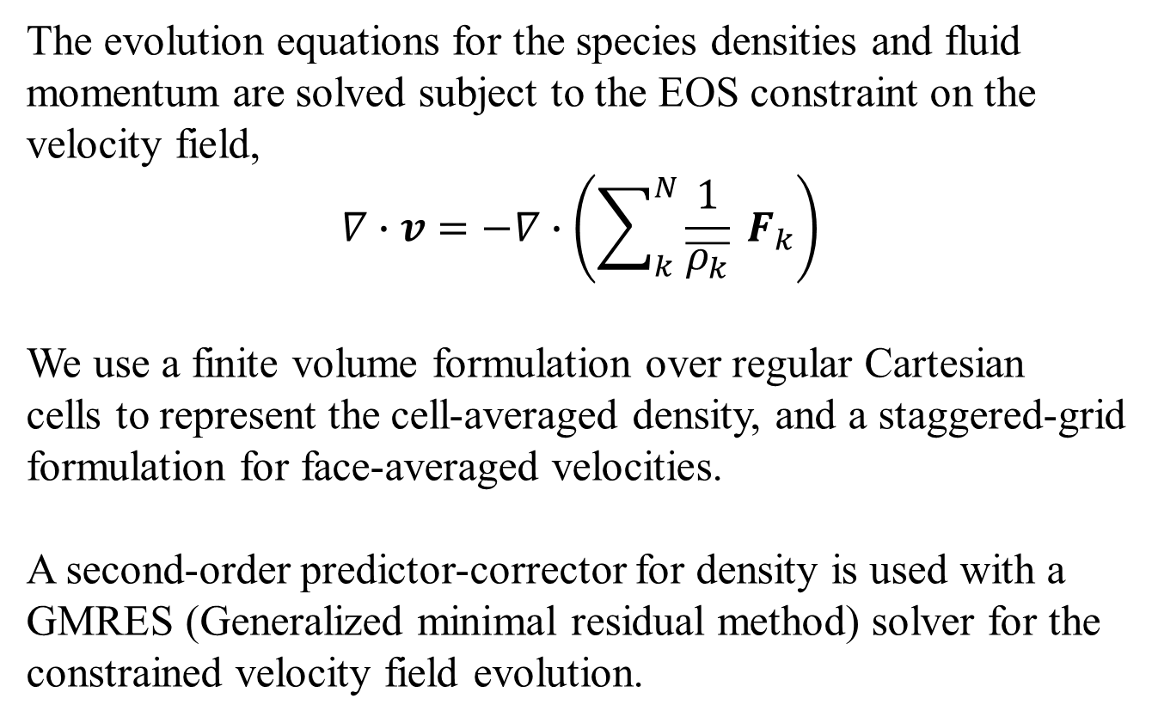
Numerics
The evolution equations for the species densities and fluid momentum are solved subject to the EOS constraint on the velocity field,
$$∇∙v=−∇∙\left(\sum_{k}^{N}{\frac{1}{\overline{ρ_{k}}} F_{k}}\right)$$
We use a finite volume formulation over regular Cartesian
cells to represent the cell-averaged density, and a staggered-grid
formulation for face-averaged velocities.
A second-order predictor-corrector for density is used with a GMRES (Generalized minimal residual method) solver for the constrained velocity field evolution.

Slide 14

Equilibrium Fluctuations
Simulations reproduce expected variances and correlations of equilibrium fluctuations (e.g., structure factor for net charge).
From simulation
From theory
$$\left\langle δq\left(k\right){δq\left(k\right)}^{∗}\right\rangle$$

Slide 15


Non-Equilibrium Fluctuations
Simulation results give the expected “giant fluctuations” spectrum, which is slightly different for charged species.
Fresher Water
$$k_{x}^{4}× \left\langle δρ_{\text{Na}}\left(k_{x}\right){δρ_{\text{Na}}\left(k_{x}\right)}^{∗}\right\rangle$$
Neutral
$$λ_{D}=0.4 −1.4 \text{nm}$$
Charged
300 nm
Saltier Water

Slide 16
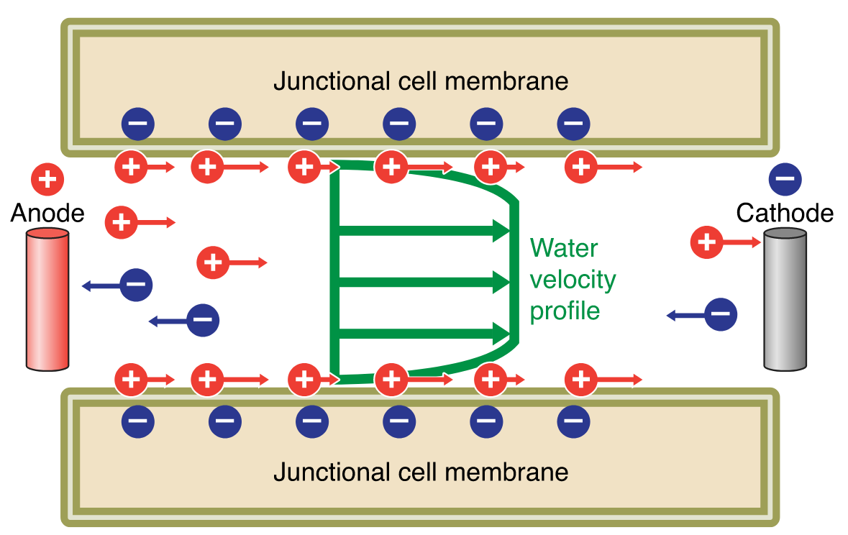
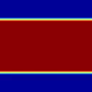

Electro-Osmosis Flow
Dilute salt water solution (0.5 mM) with an applied E-field of 100 V/cm
Fluid velocity ~ 1 cm/s
Movie shows the electric potential with applied field removed. Runtime = 3 μs
1280 nm
$$λ_{D}=25.6 \text{nm}$$

Slide 17
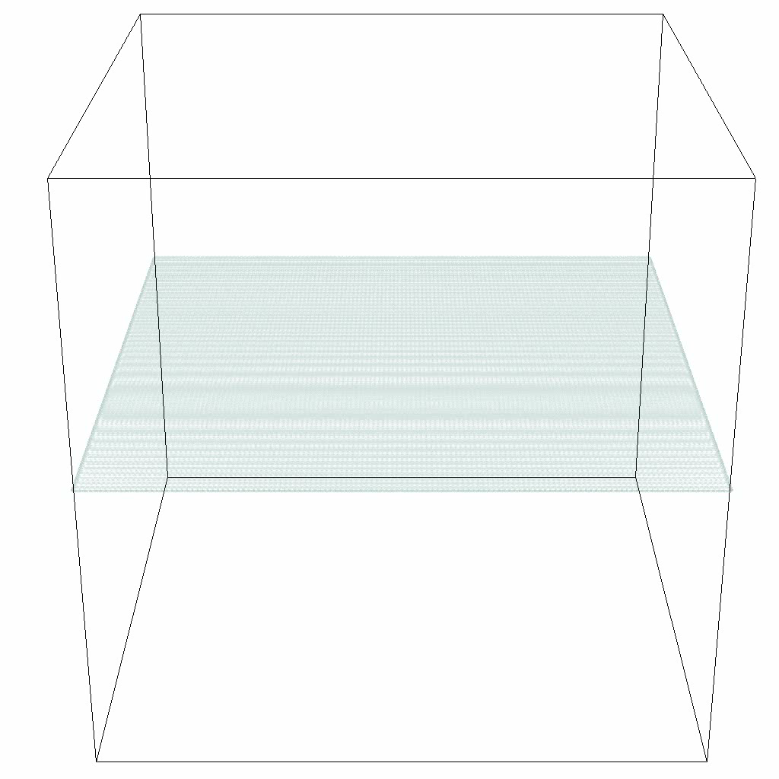
Mixing Instability
Salt Water
Saltwater on top of freshwater with a strong applied E-field in the normal (upward) direction.
Movie is 50/50 contour interface
Fresh Water
4 μm

Slide 18
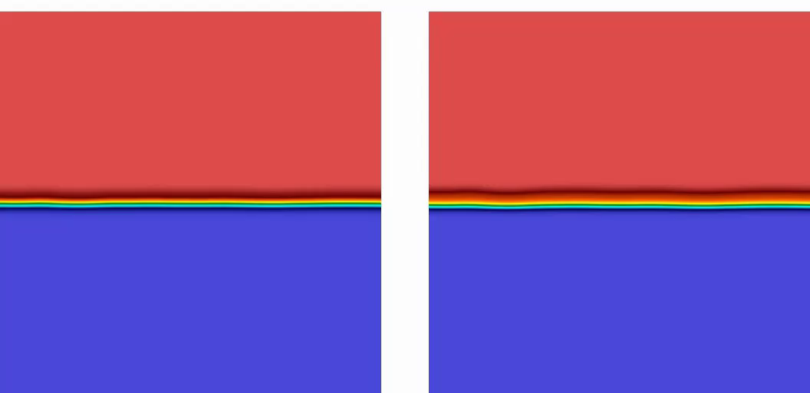
Acid-Base Fingering Instability
The chemistry modeling discussed in the previous talk (Kim, et al.) is being included in our fluctuating electro-hydrodynamics code.
HCl + NaOH → NaCl + H₂O
8 mm
NaOH on top, HCl on bottom.
Movies show sodium concentration.
Runtime is 4s of real-time
g
Modeled as molecules
Modeled as ions

Slide 19
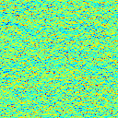
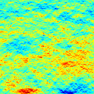
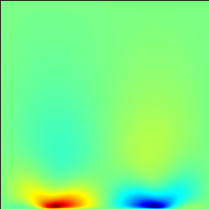
Electrochemical Micropump
Investigating systems with electrokinetic flow created by chemical reactions.
Horizontal Fluid Velocity
50 μm
Stochastic
(Instantaneous)
Stochastic
(Averaged)
Deterministic

Slide 20
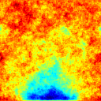
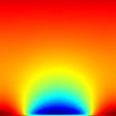
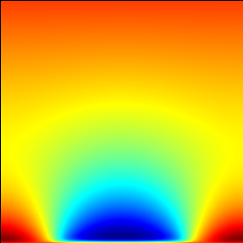
Electrochemical Micropump
Similar to electro-osmosis with ions from reactions producing the driving E-field.
Electric potential
50 μm
Stochastic
(Instantaneous)
Stochastic
(Averaged)
Deterministic

Slide 21
Summary & Future Work
Summary:
Interesting mesoscale hydrodynamic phenomena occur in electrolyte solutions.
Efficient and accurate methods exist for solving fluctuating electro-hydrodynamics with electro-chemistry.
Surface-Electrolyte Interface (SEI)
Future work:
Quasi-electroneutral
numerical scheme
Polarization effects
Interfaces
Membranes

Slide 22

Thank you for
your attention
For more information,
visit: ccse.lbl.gov
www.algarcia.org
and cims.nyu.edu/~donev
Supported
by DoE

