Slide 1



Fluctuating Hydrodynamics of Reactive Liquid Mixtures
TWENTIETH SYMPOSIUM ON THERMOPHYSICAL PROPERTIES
June 24–29, 2018 -- Boulder, CO, USA
Changho Kim, Andy Nonaka, John Bell
(Lawrence Berkeley National Lab)
Alejandro Garcia (San Jose State University)
Aleksandar Donev (New York University)

Slide 2
Two Existing Approaches
Fluctuating Hydrodynamics
(FHD)
Reaction-Diffusion Master Equation
(RDME)
(Computational) fluid dynamics
Biochemical modeling
Advantages
Computational efficiency
(for weak fluctuations)
Systematic extension to multiphysics
Accurate (Poisson) description of reaction
Limited to
Langevin (Gaussian) chemistry
Dilute solution / no fluid flow
Disadvantages
Validity for strong fluctuations?
Scalability?

Slide 3
Our Approach
FHD
Multispecies cross-diffusion
Fluid velocity
CME
(chemical master equation)
Reaction
+
“Best of both worlds”
Accurate modeling of reactive microliquids
Dilute solutions as well as liquid mixtures
Thermodynamically consistent
Obtained from a general form of chemical potential
Equilibrium distribution is given by the correct Einstein distribution
Computationally efficient
Tau-leap reaction sampling (fixed time step size)
Implicit treatment of momentum diffusion (large Schmidt number)
Numerically robust
Continuous range approximation / negative densities
Vanishing species

Slide 4
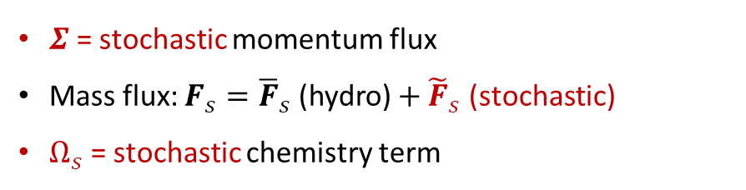
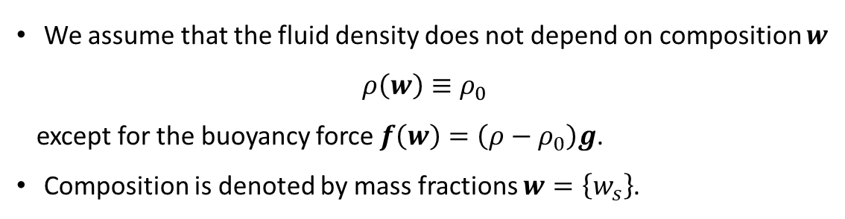
Formulation (1/3)
Isothermal Boussineq (Incompressible) Formulation
We assume that the fluid density does not depend on composition $w$
$$ρ\left(w\right)≡ρ_{0}$$
except for the buoyancy force $f\left(w\right)=\left(ρ−ρ_{0}\right)g$.
Composition is denoted by mass fractions $w=\left\{w_{s}\right\}$.
Appropriate for many liquid (mixture) systems
Complexity of numerical algorithm is greatly reduced
without losing essential physics.
$Σ$ = stochastic momentum flux
Mass flux: $F_{s}={\overline{F}}_{s}$ (hydro) $+ {\tilde{F}}_{s}$ (stochastic)
$Ω_{s}$ = stochastic chemistry term
GWN

Slide 5
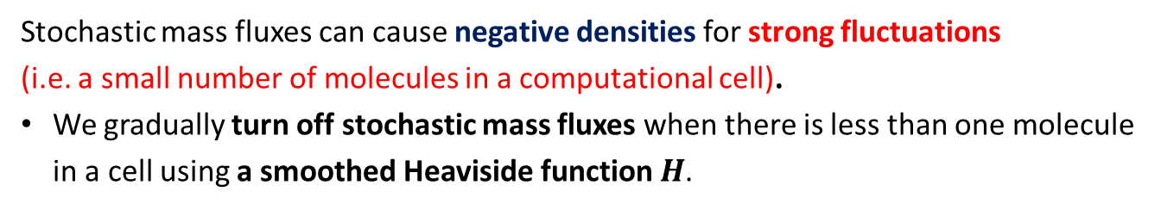
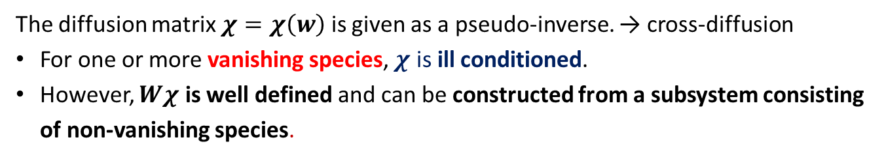

Formulation (2/3)
Multispecies Maxwell-Stefan Diffusion
$$diag\left(w\right)$$
mole fractions
Two numerical modifications
The diffusion matrix $χ=χ\left(w\right)$ is given as a pseudo-inverse. → cross-diffusion
For one or more vanishing species, $χ$ is ill conditioned.
However, $Wχ$ is well defined and can be constructed from a subsystem consisting of non-vanishing species.
Stochastic mass fluxes can cause negative densities for strong fluctuations
(i.e. a small number of molecules in a computational cell).
We gradually turn off stochastic mass fluxes when there is less than one molecule in a cell using a smoothed Heaviside function $H$.

Slide 6
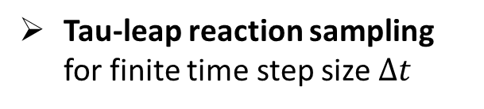
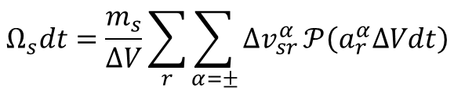
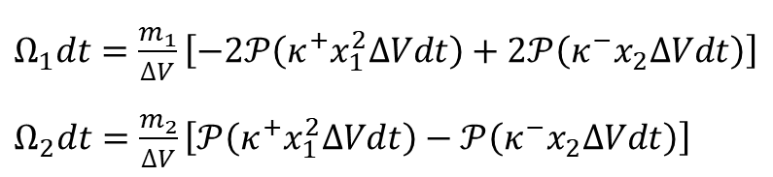
Formulation (3/3)
Stochastic Chemistry
General Case
Dimerization
(binary ideal mixture)
Generalized law of mass action (LMA)
CME-based reaction description
$$Ω_{s}dt=\frac{m_{s}}{ΔV}\sum_{r}{\sum_{α=±}{∆v_{sr}^{α}}}𝒫\left(a_{r}^{α}∆Vdt\right)$$
$Ω_{1}dt=\frac{m_{1}}{ΔV}\left[−2𝒫\left(κ^{+}x_{1}^{2}ΔVdt\right)+2𝒫\left(κ^{−}x_{2}ΔVdt\right)\right]$
$Ω_{2}dt=\frac{m_{2}}{ΔV}\left[𝒫\left(κ^{+}x_{1}^{2}ΔVdt\right)−𝒫\left(κ^{−}x_{2}ΔVdt\right)\right]$
Poisson RNG
Tau-leap reaction sampling for finite time step size $Δt$
Both the generalized LMA and CME-based description are essential for achieving thermodynamic consistency.

Slide 7
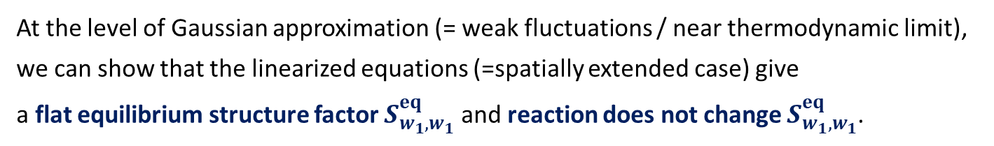
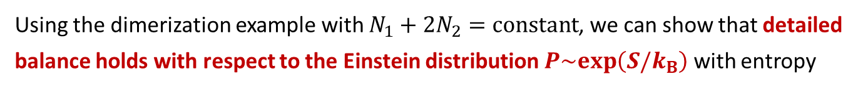

Thermodynamic Consistency
Using the dimerization example with $N_{1}+2N_{2}=constant$, we can show that detailed balance holds with respect to the Einstein distribution $P\sim exp\left(S/k_{B}\right)$ with entropy
if
and
.
Integer-based correction for $a^{+}=κ^{+}x_{1}^{2}$
At the level of Gaussian approximation (= weak fluctuations / near thermodynamic limit), we can show that the linearized equations (=spatially extended case) give
a flat equilibrium structure factor $S_{w_{1},w_{1}}^{eq}$ and reaction does not change $S_{w_{1},w_{1}}^{eq}$.

Slide 8
Numerical Scheme
Stochastic version of the method of lines approach
Spatial discretization
Structured-grid finite-volume approach
Reaction is added after spatial discretization so that finite-volume cells can be used as reactive cells.
Temporal integrator
Implicit treatment of momentum diffusion (most restrictive for liquids)
Explicit treatment of species diffusion + reaction
Midpoint predictor-corrector (second-order deterministic/weak accuracy)
Robust for the large Schmidt number

Slide 9
Dilute Solution: Hydrolysis of Sucrose
10 sucrose molecules per cell
Physically correct Poisson distribution is reproduced.
Our numerical method is simplified to our previous reaction-diffusion scheme in the dilute limit in the absence of fluid flow.

Slide 10
Binary Mixture: Dimerization
10 dimers and 20 monomers per cell (no solvent)
Numerical result is remarkably close to the Einstein distribution.
Our treatment for strong fluctuations is numerically validated beyond the dilute limit.

Slide 11
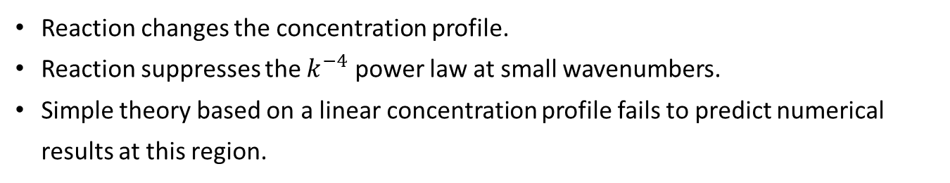
Dimerization: Giant Fluctuations
Reaction changes the concentration profile.
Reaction suppresses the $k^{−4}$ power law at small wavenumbers.
Simple theory based on a linear concentration profile fails to predict numerical results at this region.

Slide 12
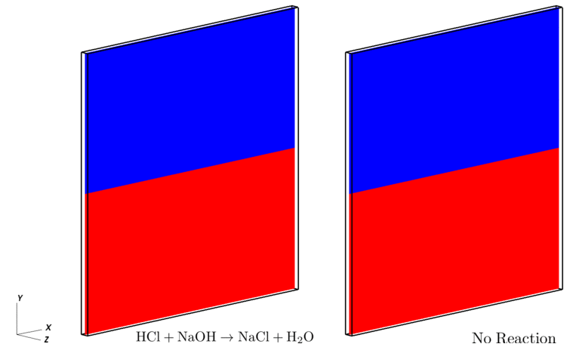
Buoyancy-Driven Instability
Double-diffusive instability in a vertically oriented Hele-Shaw cell
  HCl (dense lower layer) + NaOH (less dense upper layer); HCl diffuses faster.
Sharp interface initially prepared with natural mass/momentum fluctuations
  Ideal experiment

Slide 13
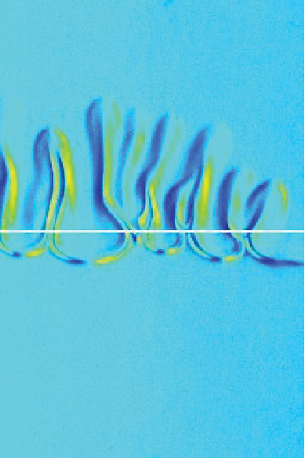
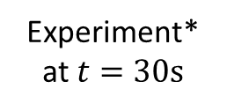
Effects of Thermal Fluctuations
Simulation A: full fluctuating hydrodynamics
Simulation C: all stochastic mass components omitted
Simulation D: initial velocity fluctuations also omitted
Velocity fluctuations dominate the triggering of the instability starting from a perfectly flat interface.
Our simulation results show that the natural fluctuations are
sufficiently large to kick off the instability on a time scale comparable to that when a macroscopic initial perturbation is imposed.
Experiment*
at $t=30s$
* L. Lemaigre, M.A. Budroni, L.A. Riolfo, P. Grosfils, and A. De Wit, Phys. Fluids, 25:014103, 2013

Slide 14
Summary
We have developed a fluctuating hydrodynamics (FHD) formulation and numerical methodology for stochastic simulation of reactive liquid mixtures.
Isothermal Boussineq formulation
Generalized LMA / CME / tau leaping
FHD with treatments for handling negative densities and vanishing species
Thermodynamically consistent formulation
Computationally efficient and robust method
Future work
Electro-chemistry with charged species (ions)

Slide 15

Thank you for
your attention
For more information,
visit: ccse.lbl.gov
www.algarcia.org
and cims.nyu.edu/~donev
Supported
by DoE
Preprint available:
http://arxiv.org/abs/1806.03389

